Slide 1
History of Java
Background information about Java and how the background affected it’s development.
Robust, Platform independent,

Slide 2
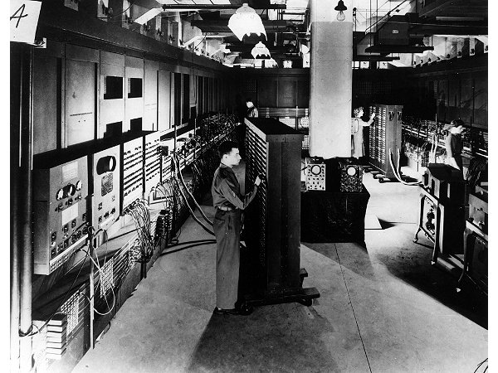
Java: History
Computers of the past
Image © University of Pennsylvania

Slide 3

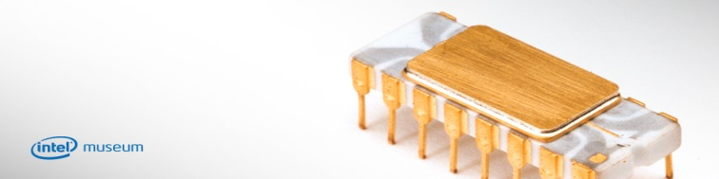
Java: History (2)
The invention of the microprocessor revolutionized computers
From the “Intel museum” www.intel.com
Image courtesy of James Tam

Slide 4
Java: History (3)
It was believed that the logical next step for microprocessors was to have them run intelligent consumer electronics.
IoT“Smart homes”, #embedded #Router www(GAN) loss of packet #lossy and lossless transmissions
“Smart washer-dryers”
“Smart vacuums”

Slide 5
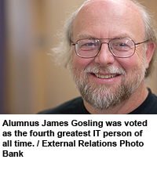
Java History (4)
Sun Microsystems funded an internal research project “Green” to investigate this opportunity.
Result: A programming language called “Oak”
Blatant advertisement: James Gosling was a graduate of the U of Calgary, in 1977 Computer Science program

Slide 6

Java History (5)
Problem: There was already a programming language called Oak.
The “Green” team met at a local coffee shop to come up with another name...
Java!

Slide 7
Java: History (6)
The concept of intelligent devices didn’t catch on.
Project Green and work on the Java language was nearly canceled.
Bug vs Debugging

Slide 8
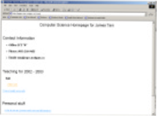
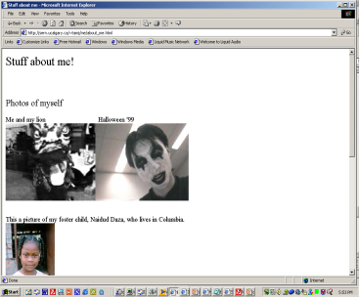

Java: History (7)
The popularity of the Internet resulted in Sun’s re-focusing of Java on computers.
Prior to the advent of Java, web pages allowed you to download only text and images.
Your computer at home running a web browser
Server containing a
web page
User clicks on a link
Images and text get downloaded

Slide 9
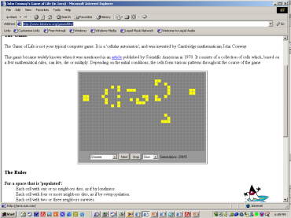
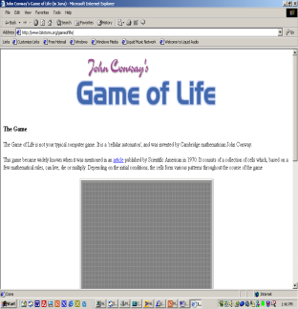
Java: History (8)
Java enabled web browsers allowed for the downloading of programs (Applets).
Java is still used in this context today:
Facebook (older version)
Hotmail (older version)
Your computer at home running a web browser
Server containing a
web page
User clicks on a link
Java applet downloaded
Java version of the Game of Life: http://www.bitstorm.org/gameoflife/
Online checkers: http://www.darkfish.com/checkers/index.html

Slide 10
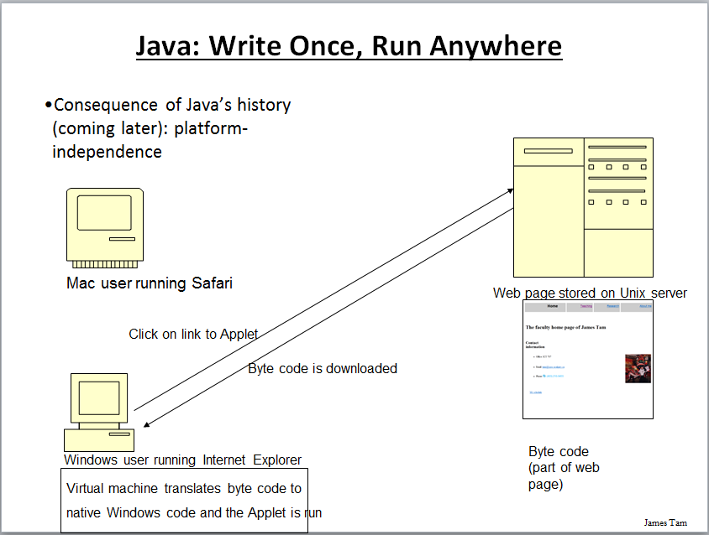
Why ‘Javac’ & ‘Java’: Consequence Of Java History

Slide 11
Adding Java Code To A Webpage
The code can be run through a web browser instead of manually invoked via the command line.
These Java programs are ‘applets’
How to create a simple Java applet:
http://docs.oracle.com/javase/tutorial/deployment/applet/getStarted.html
How to get an applet to run when your web page is accessed
http://www.ehow.com/how_7306707_run-java-applet-html.html

Slide 12
Java Timeline
Show infographics

Slide 13
Features of Java
Discuss

Slide 14
Structure of Java
public class Student //class definition
{
public static void main(String []args)
{
//statements
}
}
main()
“Hello” ‘h’, ‘e’,

Slide 15
After This Section You Should Now Know
How Java was developed and the impact of it's roots on the language
Major players and events in the development of Java

Slide 16
UNIT 1: Primitive Types in Java (2.5 – 5%)
Java Variables
Variables are containers for storing data values.
In Java, there are different types of variables, for example:
String - stores text, such as "Hello". String values are surrounded by double quotes
int - stores integers (whole numbers), without decimals, such as 123 or -123
float - stores floating point numbers, with decimals, such as 19.99 or -19.99
char - stores single characters, such as 'a' or 'B'. Char values are surrounded by single quotes
boolean - stores values with two states: true or false
Char(single letter) vs Strings (sentences)

Slide 17
Declaring (Creating) Variables
To create a variable, you must specify the type and assign it a value:
Syntax
type variable = value; #Talk about == vs = also
Example
Create a variable called name of type String and assign it the value "John":
String name = "John";
System.out.println(name);
Example
Create a variable called myNum of type int and assign it the value 15:
int myNum = 15;
System.out.println(myNum);

Slide 18
Final Variables
However, you can add the final keyword if you don't want others (or yourself) to overwrite existing values (this will declare the variable as "final" or "constant", which means unchangeable and read-only):
Example
final int myNum = 15;
myNum = 20; // will generate an error: cannot assign a value to a final variable
Double a = 10,
a = 15

Slide 19
Other Types
A demonstration of how to declare variables of other types:
Example
int myNum = 5;
float myFloatNum = 5.99f;
char myLetter = 'D';
boolean myBool = true;
String myText = "Hello";

Slide 20
Display Variables
The println() method is often used to display variables.
To combine both text and a variable, use the + character:
Example
String fname, lname = "John";
System.out.println(fname + name);
You can also use the + character to add a variable to another variable:
Example
String firstName = "John ";
String lastName = "Doe";
String fullName = firstName + lastName;
System.out.println(fullName);

Slide 21
Display Variables …contd
For numeric values, the + character works as a mathematical operator (notice that we use int (integer) variables here):
Example
int x = 5;
int y = 6;
System.out.println(x + y); // Print the value of x + y
Declare Many Variables
To declare more than one variable of the same type, use a comma-separated list:
Example
int x = 5, y = 6, z = 50;
System.out.println(x + y + z);

Slide 22
Primitive vs Non-primitive
Data types are divided into two groups:
1) Primitive data types - includes byte, short, int, long, float, double, boolean and char
2) Non-primitive data types - such as String, Arrays and Classes (you will learn more about these in a later chapter)
Primitive Data Types
A primitive data type specifies the size and type of variable values, and it has no additional methods.
There are eight primitive data types in Java:

Slide 23
Bits (8) -> 1024 Bytes -> 1024 Kilobytes -> 1024 Megabytes -> 1 Gigabytes -> Terabyte –> Petabyte
2^0 = 1 , 2^9 = 512
2^1 = 2
2^2 = 4
2^3 = 8
2^4 = 16
2^5 = 32
2^7 = 128
2^8 = 256
2^10 = 1024

Slide 24
Use float or double?
Use float or double?
The precision of a floating-point value indicates how many digits the value can have after the decimal point. The precision of float is only six or seven decimal digits, while double variables have a precision of about 15 digits. Therefore it is safer to use double for most calculations.
Scientific Numbers
A floating point number can also be a scientific number with an "e" to
Example
float f1 = 35e3f;
double d1 = 12E4d;
System.out.println(f1);
System.out.println(d1); indicate the power of 10:

